Slide 1


Francisco Molina Gambin
16/11/2022

Slide 2

Outline
Executive Summary
Introduction
Methodology
Results
Conclusion
Appendix

Slide 3
Executive Summary
Summary of methodologies
Data Collection trough API
Data Collection with Web Scrapping
Data Wrangling
Exploratory Data Analysis with SQL
Exploratory Data Analysis with Data Visualization
Interactive Visual Analytics with Folium
Machine learning Prediction
Summary of all results
Exploratory Data Analysis results
Interactive analytics in screenshots
Predictive Analysis results

Slide 4
Introduction
Project background and context
Space Exploration Technologies Corp., conocida como SpaceX, es una empresa estadounidense de fabricación aeroespacial y de servicios de transporte espacial con sede en Hawthorne (California). Fue fundada en 2002 por Elon Musk con el objetivo de reducir los costes de viajar al espacio para facilitar la colonización de Marte.​ SpaceX ha desarrollado varios vehículos de lanzamiento, la constelación Starlink la nave de carga Dragon y llevado astronautas a la Estación Espacial Internacional en la Dragon 2
Problems you want to find answers
Factors to determine a successful land of the rocket
How to determine a successful rate of successful landing
Conditions needed for a successful landing program

Slide 5

Section 1

Slide 6
Methodology
Executive Summary
Data collection methodology:
SpaceX API and web scraping from WIkipedia
Perform data wrangling
One hot enconding to categorical features
Perform exploratory data analysis (EDA) using visualization and SQL
Perform interactive visual analytics using Folium and Plotly Dash
Perform predictive analysis using classification models
How to build, tune, evaluate classification models

Slide 7
Data Collection
Describe how data sets were collected.
Data collection was made with get request in SpaceX API
Then, Json was used using .json() function call and then turned to pandas datraframe with .json normalize()
Then, cleaned data and checked missing values and fill missing values
Also, web scrapping from Wikipedia with BeautifulSoup
For extracting and HTML table and convert it to pandas dataframe

Slide 8
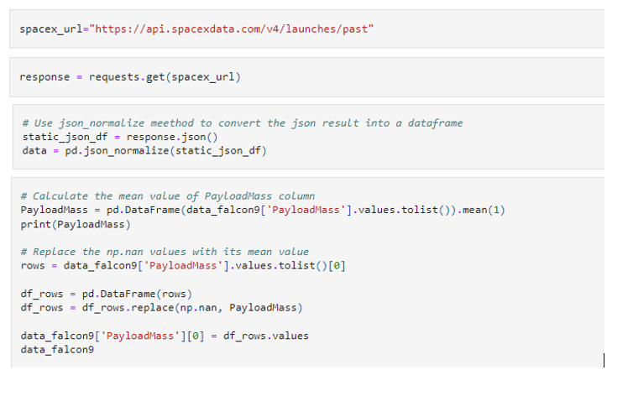
Data Collection – SpaceX API
Present your data collection with SpaceX REST calls using key phrases and flowcharts
Add the GitHub URL of the completed SpaceX API calls notebook https://github.com/FranMG99/Final-project/blob/298bd834b4812422768adab9de56ced7a62a58c5/jupyter-labs-spacex-data-collection-api.ipynb
Place your flowchart of SpaceX API calls here

Slide 9
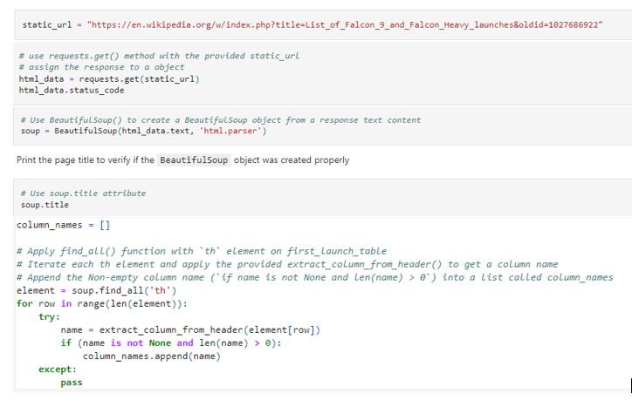
Data Collection - Scraping
Present your web scraping process using key phrases and flowcharts
Add the GitHub URL of the completed web scraping notebook, https://github.com/FranMG99/Final-project/blob/298bd834b4812422768adab9de56ced7a62a58c5/jupyter-labs-webscraping%20(1).ipynb
Place your flowchart of web scraping here

Slide 10
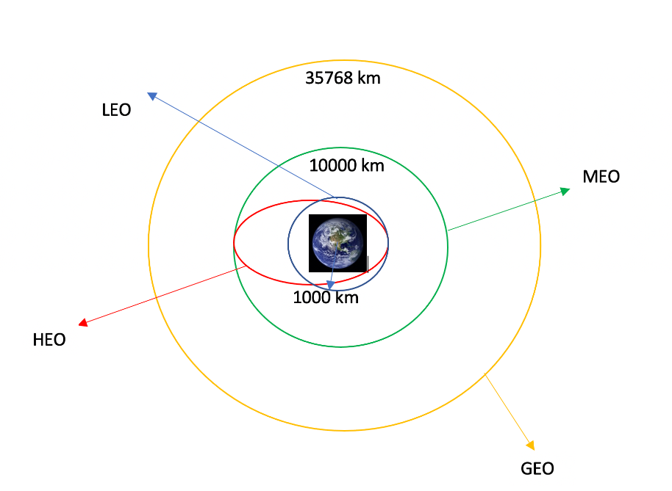
Data Wrangling
Data were processed with data analysis and training labels
Number of launches from the different places and the frequence of the orbits was calculated
And then we saved to a csv
Add the GitHub URL of your completed data wrangling related notebooks, https://github.com/FranMG99/Final-project/blob/298bd834b4812422768adab9de56ced7a62a58c5/labs-jupyter-spacex-data_wrangling_jupyterlite.jupyterlite.ipynb

Slide 11
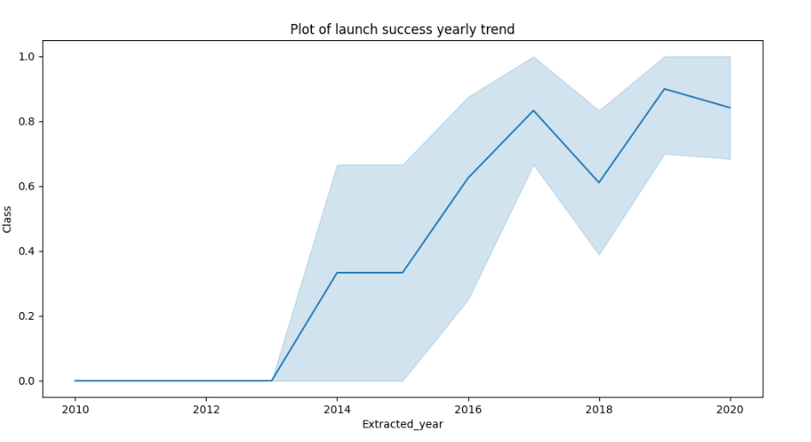
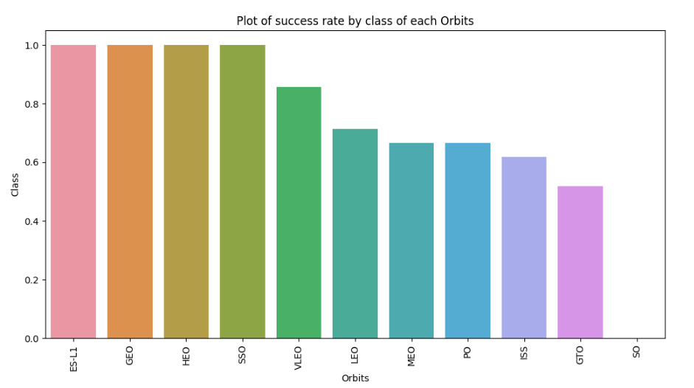
EDA with Data Visualization
I used a bar plot chart and a line plot chart to observe which orbit have higher success rate and to observe that the success rate sinc e2013 kept increasing till 2020
Add the GitHub URL of your completed EDA with data visualization notebook, https://github.com/FranMG99/Final-project/blob/f05cef84686f5fa5d333bd6a7b2586107494063b/jupyter-labs-eda-dataviz.ipynb.jupyterlite%20(1).ipynb

Slide 12
EDA with SQL
Names of unique launch sites
Total payload mass carried by boosters launched by NASA
Average payload mass carried by booster version F9 v1.1
Total number of successful and failure mission outcomes
Failed landing outcomes in drone ship, booster version and launch site names
Add the GitHub URL of your completed EDA with SQL notebook, https://github.com/FranMG99/Final-project/blob/f05cef84686f5fa5d333bd6a7b2586107494063b/jupyter-labs-eda-sql-coursera_sqllite.ipynb

Slide 13
Build an Interactive Map with Folium
I marked all launch sites, and added map objects such as markers, circles, lines
I assigned the feature launch outcomes (failure or success) to class 0 and 1
I identified which launch sites have relatively high success rate, using color-labeled marker clusters
I calculated the distances between a launch site to its proximities.
Add the GitHub URL of your completed interactive map with Folium map, https://github.com/FranMG99/Final-project/blob/8930fa6799758096d5560bc8408ab0760f188679/lab_jupyter_launch_site_location.jupyterlite%20(3).ipynb I don’t know why the maps are not shown even that I have the notebook trusted so I put the pics in a pdf in the github too.

Slide 14
Predictive Analysis (Classification)
I loaded the data using numpy and pandas, transformed the data, and splitted the data into training and testing.
I built different machine learning models and used GridSearchCV.
I used accuracy as the metric for the model and improved the model using feature engineering and algorithm tuning.
And found the best performing classification model
Add the GitHub URL of your completed predictive analysis lab, https://github.com/FranMG99/Final-project/blob/43cbb27b7bd1e2e6351d23bbfd79eb82439da7ef/SpaceX_Machine_Learning_Prediction_Part_5.jupyterlite.ipynb

Slide 15
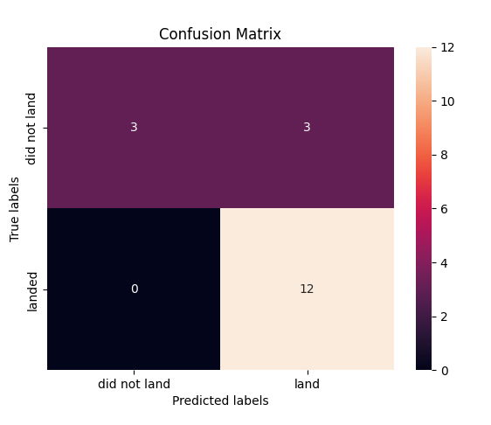
Results
Exploratory data analysis results
Interactive analytics demo in screenshots
Predictive analysis results

Slide 16

Section 2

Slide 17
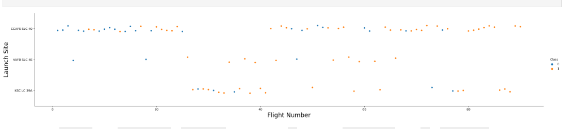
Flight Number vs. Launch Site
We see that more amount of the number of the fligst increase the success rate in a launch site

Slide 18
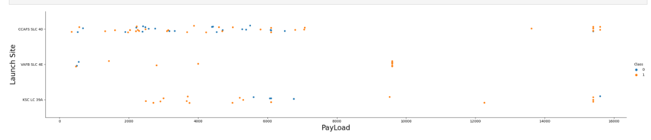
Payload vs. Launch Site
Now if you observe Payload Vs. Launch Site scatter point chart you will find for the VAFB-SLC launch site there are no rockets launched for heavy payload mass

Slide 19
Success Rate vs. Orbit Type
The first four are the ones with more success rate

Slide 20
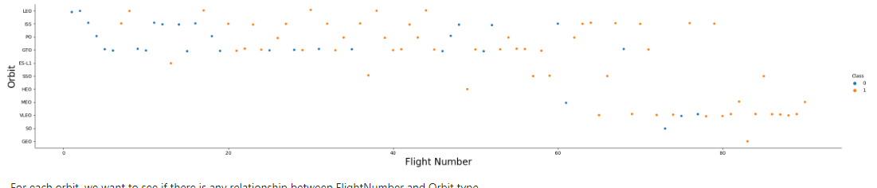
Flight Number vs. Orbit Type
You should see that in the LEO orbit the Success appears related to the number of flights; on the other hand, there seems to be no relationship between flight number when in GTO orbit.

Slide 21
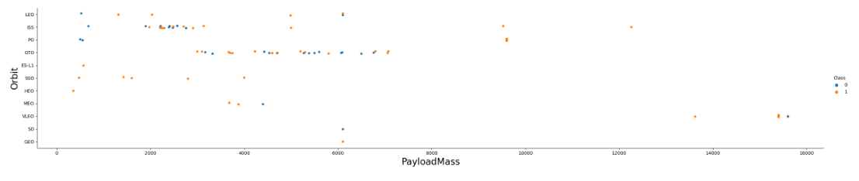
Payload vs. Orbit Type
With heavy payloads the successful landing or positive landing rate are more for Polar,LEO and ISS.
However, for GTO we cannot distinguish this well as both positive landing rate and negative landing(unsuccessful mission) are both there here.

Slide 22
Launch Success Yearly Trend
You can observe that the success rate since 2013 kept increasing till 2020

Slide 23
All Launch Site Names
The different launch site names are:
KSC LC-39A
CCAFS LC-40
CCAFS SLC-40
VAFB SLC-4E

Slide 24
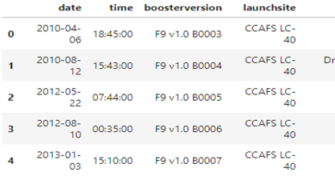
Launch Site Names Begin with 'CCA'
Find 5 records where launch sites begin with `CCA`

Slide 25
Total Payload Mass
The total Payload Mass is 45596

Slide 26
Average Payload Mass by F9 v1.1
The average payload mass carried by booster version F9 v1.1 is 2928.4

Slide 27
First Successful Ground Landing Date
The dates of the first successful landing outcome on ground pad was 2015-12-22

Slide 28
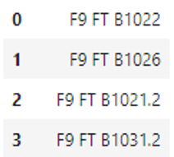
Successful Drone Ship Landing with Payload between 4000 and 6000
List the names of boosters which have successfully landed on drone ship and had payload mass greater than 4000 but less than 6000

Slide 29
Total Number of Successful and Failure Mission Outcomes
Calculate the total number of successful and failure mission outcomes
Successful: 100
Failure: 1

Slide 30
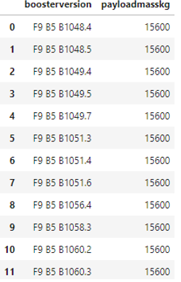
Boosters Carried Maximum Payload
List the names of the booster which have carried the maximum payload mass

Slide 31
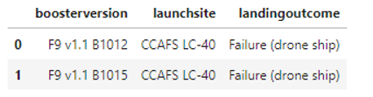
2015 Launch Records
List the failed landing_outcomes in drone ship, their booster versions, and launch site names for in year 2015

Slide 32
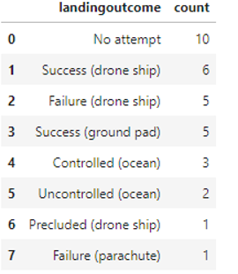
Rank Landing Outcomes Between 2010-06-04 and 2017-03-20
Rank the count of landing outcomes (such as Failure (drone ship) or Success (ground pad)) between the date 2010-06-04 and 2017-03-20, in descending order

Slide 33

Section 3

Slide 34
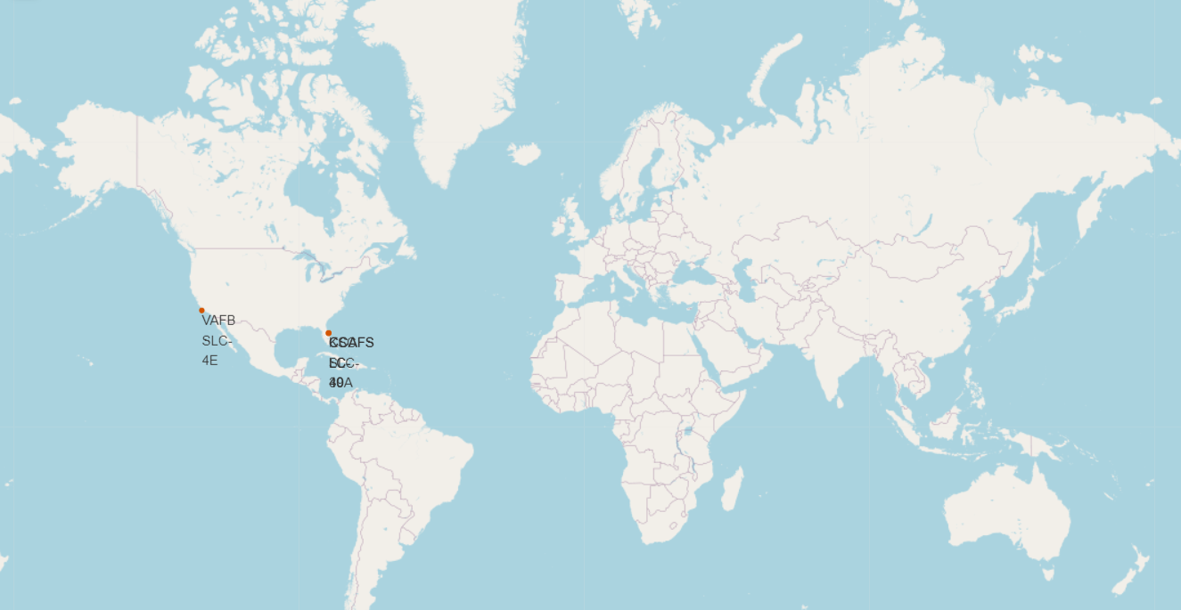
<Folium Map Screenshot 1>
Only launches in the dots

Slide 35
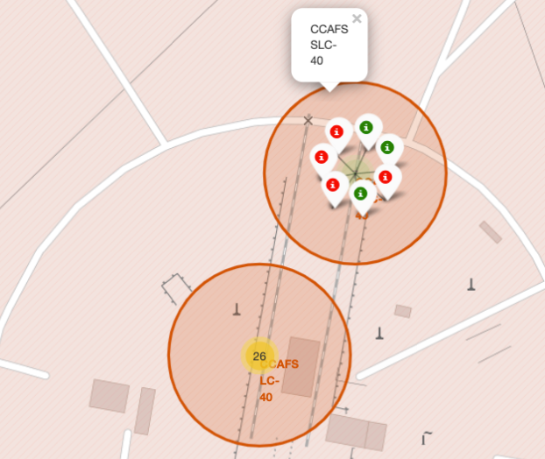
<Folium Map Screenshot 2>
All the launches in california. Green means successful and red failure

Slide 36
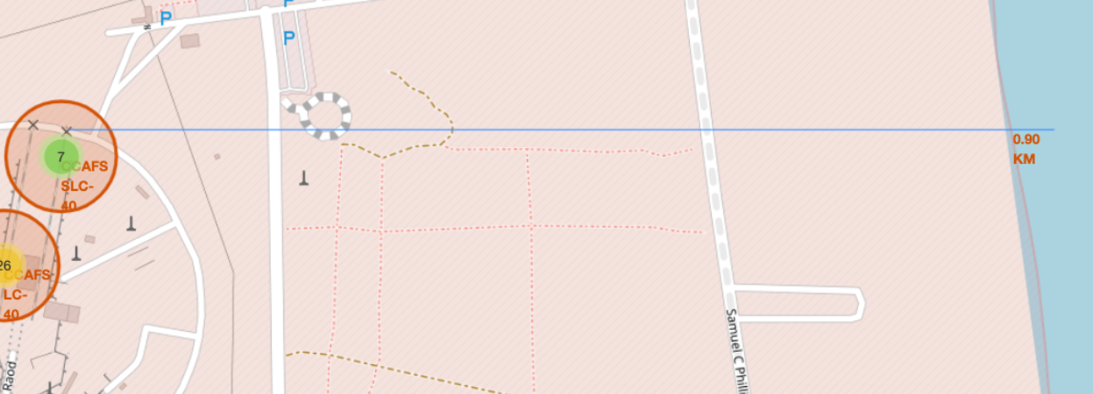
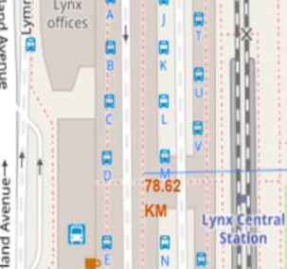
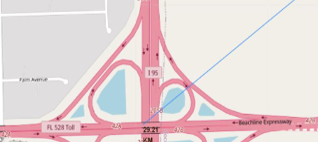
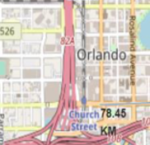
<Folium Map Screenshot 3>
Distance to train station
Distance to coastline
Distance to Orlando
Distance to highway

Slide 37

Section 5

Slide 38
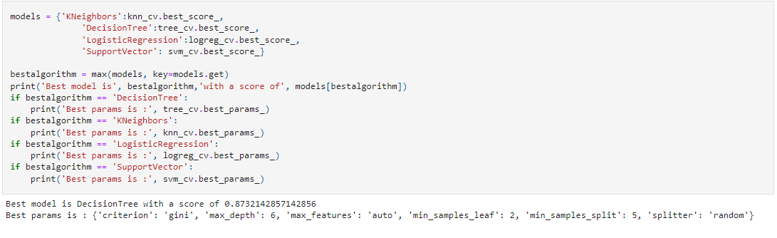
Classification Accuracy
It says that the decision tree is the most accurate

Slide 39
Confusion Matrix
It shows that the classifier can distinguish between the different classes

Slide 40
Conclusions
More number of flighst at a launch site means that greater is the success rate at a launch site.
Launch success rate started to increase in 2013 till 2020.
Orbits ES-L1, GEO, HEO, SSO, VLEO had the most success rate.
KSC LC-39A had the most successful launches of any sites.
The Decision tree classifier is the best algorithm

Slide 41


